Slide 1
Outline
1.1 Data Communications
1.2 Networks
1.3 Network Types
1.<number>
Notes:
1.#

Slide 2

Objective
The first section introduces data communications and defines their components and the types of data exchanged. It also shows how different types of data are represented and how data is flowed through the network.
The second section introduces networks and defines their criteria and structures. It introduces four different network topologies
The third section discusses different types of networks: LANs, WANs, and internetworks (internets). It also introduces the Internet, the largest internet in the world. The concept of switching is also introduced in this section to show how small networks can be combined to create larger ones.
1.<number>
Notes:
1.#

Slide 3
    1-1 DATA COMMUNICATIONS
When we communicate, we are sharing information. This sharing can be local or remote.
The term telecommunication, which includes telephony, telegraph, and television, means communication at a distance.
Data communications are the exchange of data between two devices via some form of transmission media.
1.<number>
Notes:
1.#

Slide 4
Data Communications
The word “Data” refers to information presented in whatever form is agreed upon by the parties creating and using the data.
Fundamental Characteristics of effective data communications system
Delivery
  The system must deliver data to the correct destination. Data must be received by the intended device or user and only by that device or user
Accuracy
  The system must deliver the data accurately. Data that have been altered in transmission and left uncorrected are unusable
Timeliness
  The system must deliver data in a timely manner. Data delivered late are useless.
Jitter
  Jitter refers to the variation in the packet arrival time. It is the uneven delay in the delivery of audio or video packets
1.<number>
Notes:
1.#

Slide 5
1.1.1 Components
A data communications system has five components
1.Message
  The message is the information (data) to be communicated.
  Ex : text, numbers, pictures, audio, and video.
2. Sender
  Device that sends the data message. It can be a computer, workstation, telephone handset, video camera, and so on.
3. Receiver
  Device that receives the message. It can be a computer,
  workstation, telephone handset, television, and so on.
4. Transmission medium
Physical path by which a message travels from sender to receiver.
Ex : Twisted-pair wire, coaxial cable, fiber-optic cable, and radio waves.
5. Protocol
A protocol is a set of rules that govern data communications. It represents an agreement between the communicating devices.
1.<number>
Notes:
1.#

Slide 6
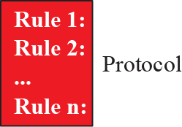
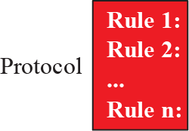
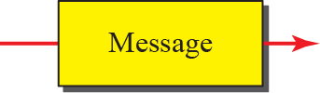


Figure 1.1: Five components of data communication
1.<number>
Notes:
1.#

Slide 7
1.1.2 Data Representation
Information today comes in different forms such as text, numbers, images, audio, and video.
1.<number>
Notes:
1.#

Slide 8
Communication between two devices
1.1.3 Data Flow
Simplex mode
  Communication is unidirectional.
  Only one of the two devices on a link can transmit; the other can only receive.
  Can use the entire capacity of the channel to send data in one direction.
  Ex : Keyboards and traditional monitors
Half-Duplex
  each station can both transmit and receive, but not at the same time.
  the entire capacity of a channel is taken over by whichever of the two devices is transmitting at the time. Ex : Walkie-Talkie
1.<number>
Notes:
1.#

Slide 9
Communication between two devices contd..
1.1.3 Data Flow
Full-Duplex
  Both stations can transmit and receive simultaneously
  Signals going in one direction share the capacity of the link with signals going in the other direction.
  This sharing can occur in two ways:
    Either the link must contain two physically separate transmission paths, one for sending and the other for receiving;
    Or the capacity of the channel is divided between signals traveling in both directions.
  Ex : Telephone network.
  When two people are communicating by a telephone line, both can talk and listen at the same time.
1.<number>
Notes:
1.#

Slide 10
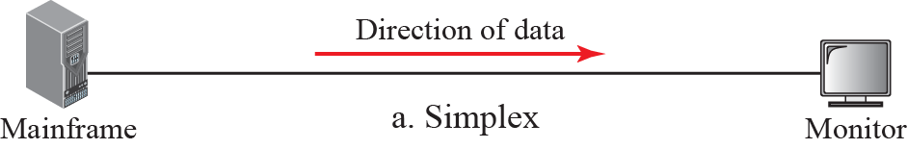
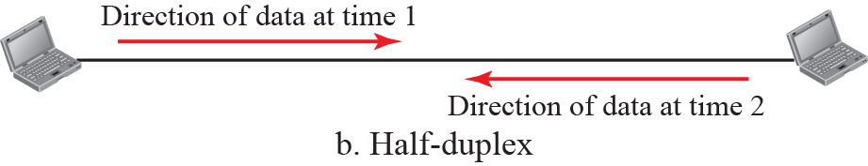
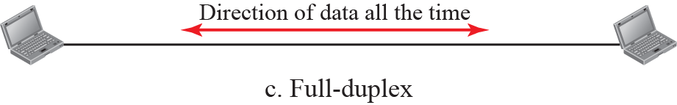
Figure 1.2: Data flow
1.<number>
Notes:
1.#

Slide 11


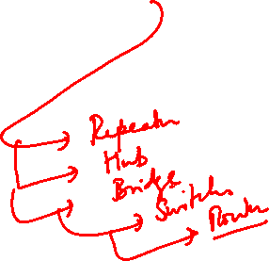
    1-2 NETWORKS
A network is the interconnection of a set of devices capable of communication.
A device can be a host such as a large computer, desktop, laptop, workstation, cellular phone, or security system.
A device in this definition can also be a connecting device such as a router, a switch, a
modem that changes the form of data, and so on.
1.<number>
Notes:
1.#

Slide 12

1.2.1 Network Criteria
A network must be able to meet a certain number of criteria. The most important of these are performance, reliability, and security.
Performance
Transit time , Response Time
Number of users, the type of transmission medium, the capabilities of the connected hardware, and the efficiency of the software
Throughput & Delay/Latency
Reliability
Frequency of failure, the time it takes a link to recover from a failure,
Network's robustness in a catastrophe
Security
Protecting data from unauthorized access
1.<number>
Notes:
1.#

Slide 13

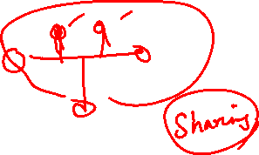
Type of Connection
1.2.2 Physical Structures –
Point-to-Point
  Dedicated link between two devices.
  Entire capacity of the link is reserved for transmission between those two devices.
Multipoint (multidrop) connection
  More than two specific devices share a single link
  In a multipoint environment, the capacity of the channel is shared, either spatially or temporally.
  If several devices can use the link simultaneously, it is a spatially shared connection.
  If users must take turns, it is a timeshared connection.
1.<number>
Notes:
1.#

Slide 14
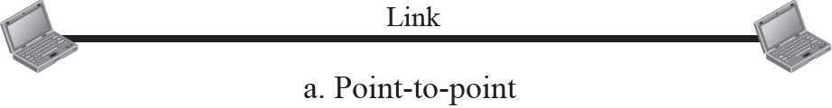
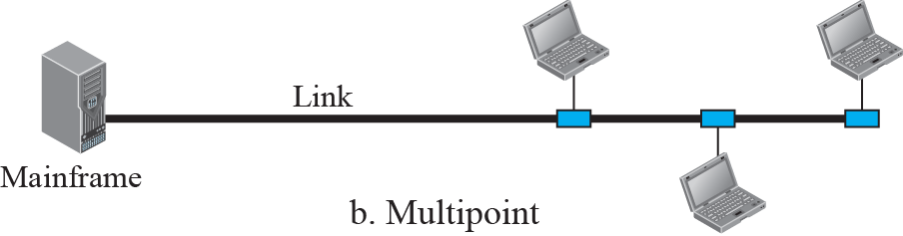
Figure 1.3: Types of connection
1.<number>
Notes:
1.#

Slide 15

Physical Topology
Way in which a network is laid out physically.
Topology of network is the geometric representation of the relationship of all the links and linking devices (usually called nodes) to one another.
Fig Categories of topology
1.<number>

Slide 16
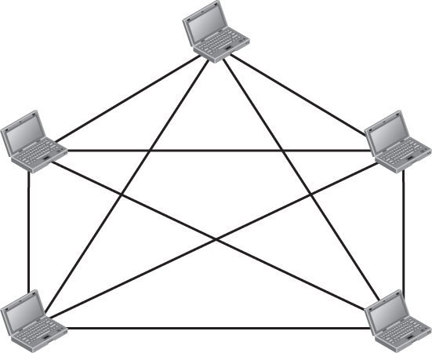


Figure 1.4: A fully-connected mesh topology
1.<number>
Notes:
1.#

Slide 17
Mesh Topology
Every device has a dedicated point-to-point link to every other device.
Number of physical links in a fully connected mesh network with n nodes = n(n-1)/2 duplex links.
Advantages
  Dedicated link guarantees that each connection can carry its own data load. Eliminating the traffic problems that can occur when links must be shared by multiple devices.
  Robust Topology. If one link becomes unusable, it does not incapacitate the entire system.
  Privacy or security. Only the intended recipient sees it.
  Point-to-point links make fault identification and fault isolation easy
1.<number>

Slide 18
Mesh Topology contd..
Disadvantages
  Amount of cabling and the number of I/O ports required
  Installation and reconnection are difficult.
  Sheer bulk of the wiring can be greater than the available space.
  Usually implemented in a limited fashion,
  Ex : as a backbone connecting the main computers of a hybrid network that can include several other topologies.
  Connection of telephone regional offices in which each regional office needs to be connected to every other regional office
1.<number>

Slide 19
Star Topology
Each device has a dedicated point-to-point link only to a central controller (usually HUB)
Unlike a mesh, does not allow direct traffic between devices.
The controller acts as an exchange.
If one device wants to send data to another. (Data -> Controller (Relays) -> Destination).
1.<number>

Slide 20
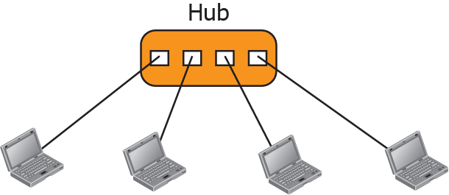
Figure 1.5: A star topology
1.<number>
Notes:
1.#

Slide 21
Star Topology contd..
Advantages
  Less expensive than mesh topology
  Each device needs only one link and one I/O port to connect it to any number of others.
  Makes it easy to install and reconfigure.
  Less cabling needs to be housed, and additions, moves, and deletions involve only one connection: between that device and the hub.
  Robustness. If one link fails, only that link is affected
Disadvantages
  Dependency of the whole topology on one single point, the hub.
  If the hub goes down, the whole system is dead.
  The star topology is used in local-area networks (LANs),
1.<number>

Slide 22
Bus Topology
Multipoint compared to other point to point connections.
One long cable acts as a backbone to link all the devices in a network.
Nodes are connected to the bus cable by drop lines and taps.
A drop line is a connection running between the device and the main cable.
A tap is a connector that either splices into the main cable or punctures the sheathing of a cable to create a contact with the metallic core.
As a signal travels along the backbone, some of its energy is transformed into heat. Therefore, it becomes weaker and weaker as it travels farther and farther.
Limit on the number of taps a bus can support and on the distance between those taps
1.<number>

Slide 23
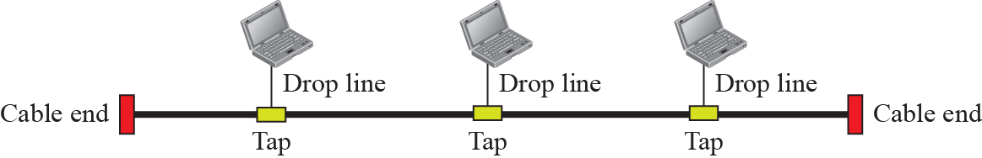
Figure 1.6: A bus topology
1.<number>
Notes:
1.#

Slide 24
Bus Topology contd..
Advantages
  Ease of installation.
  Backbone cable can be laid along the most efficient path, then connected to the nodes by drop lines of various lengths.
  Bus uses less cabling than mesh or star topologies.
Disadvantages
  Difficult reconnection and fault isolation.
  Signal reflection at the taps can cause degradation in quality. This degradation can be controlled by limiting the number and spacing of devices connected to a given length of cable.
  Adding new devices may therefore require modification or replacement of the backbone.
  A fault or break in the bus cable stops all transmission. The damaged area reflects signals back in the direction of origin, creating noise in both directions.
  Ex : Ethernet LANs can use a bus topology used in early LANs
  9
1.<number>

Slide 25
Ring Topology
Each device has a dedicated point-to-point connection with only the two devices on either side of it.
A signal is passed along the ring in one direction, from device to device, until it reaches its destination.
Each device in the ring incorporates a repeater.
When a device receives a signal intended for another device, its repeater regenerates the bits and passes them along.
1.<number>

Slide 26
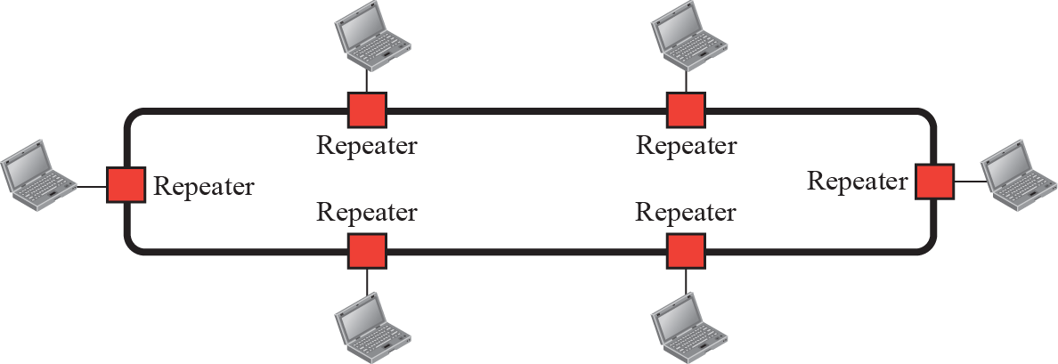
Figure 1.7: A ring topology
1.<number>
Notes:
1.#

Slide 27
Ring Topology contd..
Advantages
  Easy to install and reconfigure.
  Each device is linked to only its immediate neighbors (either physically or logically).
  The only constraints are media and traffic considerations (maximum ring length and number of devices).
  Fault isolation is simplified
Disadvantages
  Unidirectional traffic can be a disadvantage.
  A break in the ring (such as a disabled station) can disable the entire network.
  This weakness can be solved by using a dual ring.
  Ring topology was prevalent when IBM introduced its local-area network Token Ring
1.<number>

Slide 28


Hybrid Topology
Figure 1.9 A hybrid topology: a star backbone with three bus networks
1.<number>

Slide 29
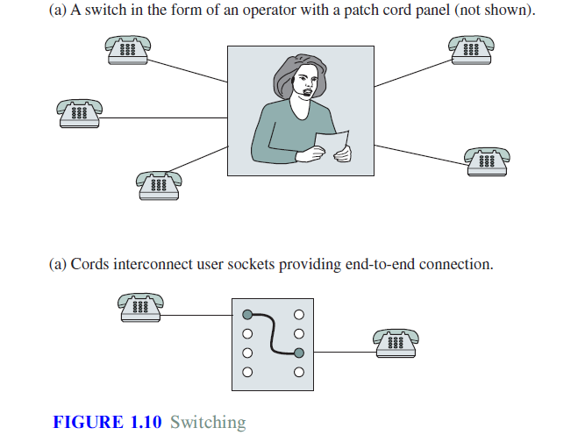
1.<number>

Slide 30
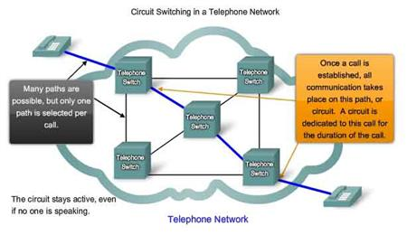

Circuit Switching
Circuit switching was designed in 1878 in order to send telephone calls down a dedicated channel.
This channel remains open and in use throughout the whole call and cannot be used by any other phone calls.

Slide 31
Circuit Switching
There are three phases in circuit switching:
  Establish
  Transfer
  Disconnect
The telephone message is sent all together; it is not broken up.
The message arrives in the same order that it was originally sent.

Slide 32
Circuit Switching
In modern circuit-switched networks, electronic signals pass through several switches before a connection is established.
During a call no other network traffic can use those switches.
The resources remain dedicated to the circuit during the entire data transfer and the entire message follows the same path.
Circuit switching can be analog or digital.

Slide 33
Circuit Switching
With the expanded use of the Internet for voice and video, analysts predict a gradual shift away from circuit-switched networks.
Advantages
    Circuit is dedicated to the call – no interference, no sharing
    Guaranteed the full bandwidth for the duration of the call
    Guaranteed quality of service

Slide 34
Circuit Switching
Disadvantages
    Inefficient – the equipment may be unused for a lot of the call; if no data is being sent, the dedicated line still remains open.
    It takes a relatively long time to set up the circuit.
    During a crisis or disaster, the network may become unstable or unavailable.
    It was primarily developed for voice traffic rather than data traffic.

Slide 35
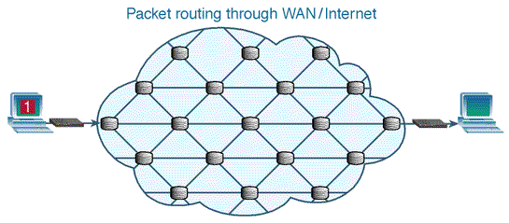
Packet Switching
In packet-based networks, the message gets broken into small data packets.
These packets are sent out from the computer and they travel around the network seeking out the most efficient route to travel as circuits become available.
This does not necessarily mean that they seek out the shortest route.
Each packet may go a different route from the others.

Slide 36
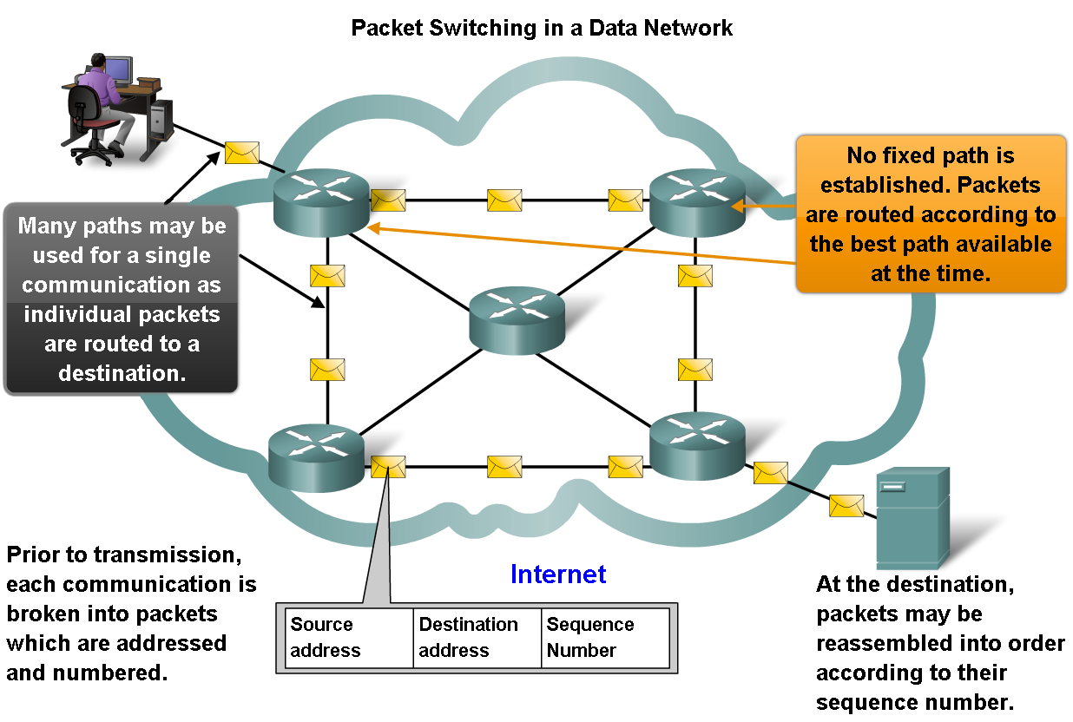
Packet Switching
Helps improve the resiliency and fault tolerance of the Internet architecture

Slide 37
Packet Switching
Advantages
    Bandwidth used to full potential
    Devices of different speeds can communicate
    Not affected by line failure (redirects signal)
    Availability – no waiting for a direct connection to become available
  Disadvantages
    Under heavy use there can be a delay
    Data packets can get lost or become corrupted
    Protocols are needed for a reliable transfer
    Not so good for some types data streams (e.g. real-time video streams can lose frames due to the way packets arrive out of sequence)

Slide 38
1-4 PROTOCOLS AND STANDARDS
In this section, we define two widely used terms: protocols and standards. First, we define protocol, which is synonymous with rule. Then we discuss standards, which are agreed-upon rules.
Topics discussed in this section:
Protocols
Standards
Standards Organizations
Internet Standards
1.<number>
Notes:
1.#

Slide 39
PROTOCOLS AND STANDARDS
A protocol
  a set of rules that govern data communications.
  what is communicated, how it is communicated, and when it is communicated.
Key elements
  Syntax
    Structure or format of the data.
    Order of presentation ; 1st 8 bits ?
  Semantics
    meaning of each section of bits
    How is a particular pattern to be interpreted? What action?
  Timing
    When data should be sent ? how fast they can be sent?
1.<number>

Slide 40
STANDARDS
Creating and maintaining an open and competitive market for equipment manufacturers.
Guarantee national and international interoperability of data and telecommunications technology and processes.
Provide guidelines
  manufacturers,
  vendors,
  government agencies, and
  service providers
de facto (meaning "by fact" or "by convention") and de jure (meaning "by law" or "by regulation").
1.<number>

Slide 41
Standards Organizations
International Organization for Standardization (ISO)
  active in developing cooperation in the realms of scientific, technological, and economic activity
International Telecommunication Union-Telecommunication Standards Sector (ITU-T).
American National Standards Institute (ANSI).
Institute of Electrical and Electronics Engineers (IEEE).
1.<number>

